Slide 1
BS Data Science 2nd Semester Lecture
Applied Physics
Electromagnetic Induction
Presented By
Dr. Arifa Mirza
Punjab University College of Information Technology

Slide 2
Faraday’s Law of Electromagnetic Induction

Slide 3
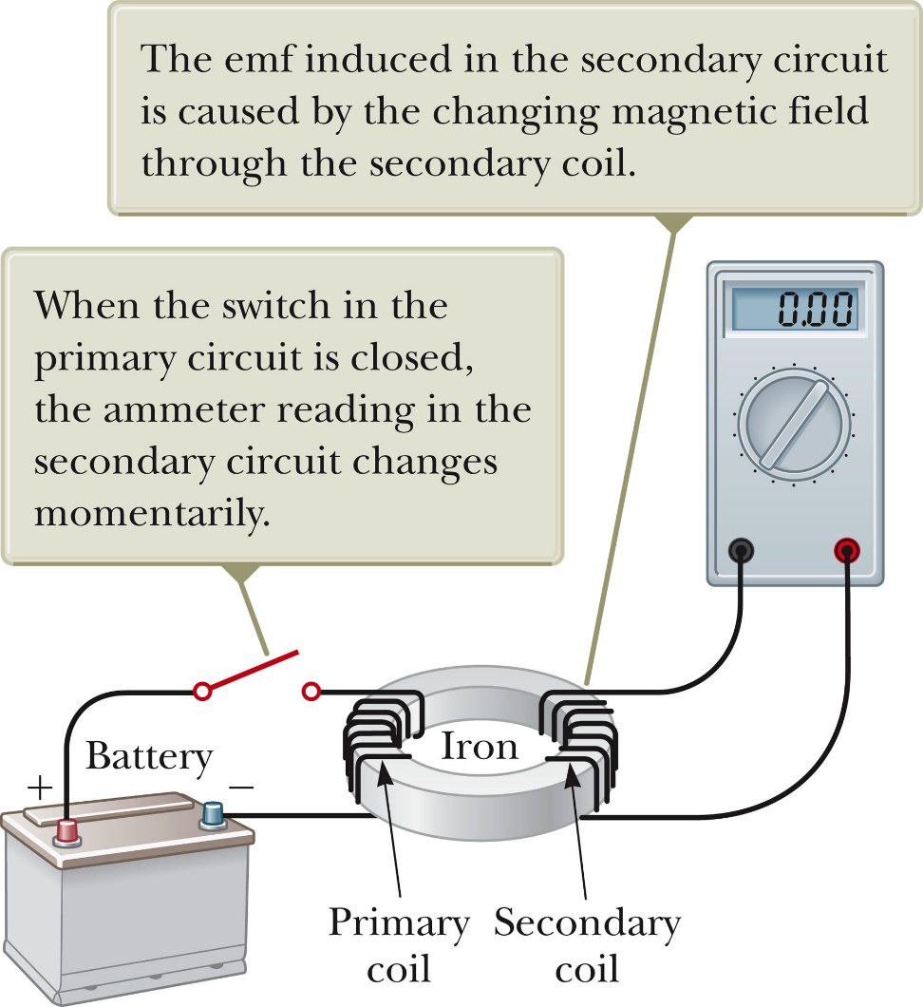
Faraday’s Experiment – Set Up
A primary coil is connected to a switch and a battery.
The wire is wrapped around an iron ring.
A secondary coil is also wrapped around the iron ring.
There is no battery present in the secondary coil.
The secondary coil is not directly connected to the primary coil.

Slide 4
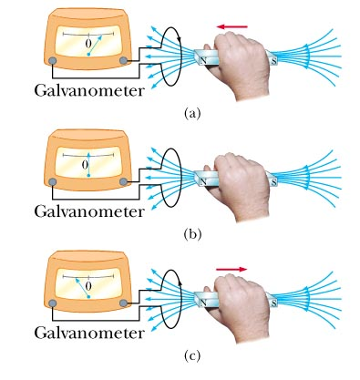
Electromagnetic Induction

Slide 5
Faraday’s Law of Induction
A changing magnetic flux induces an EMF

Slide 6
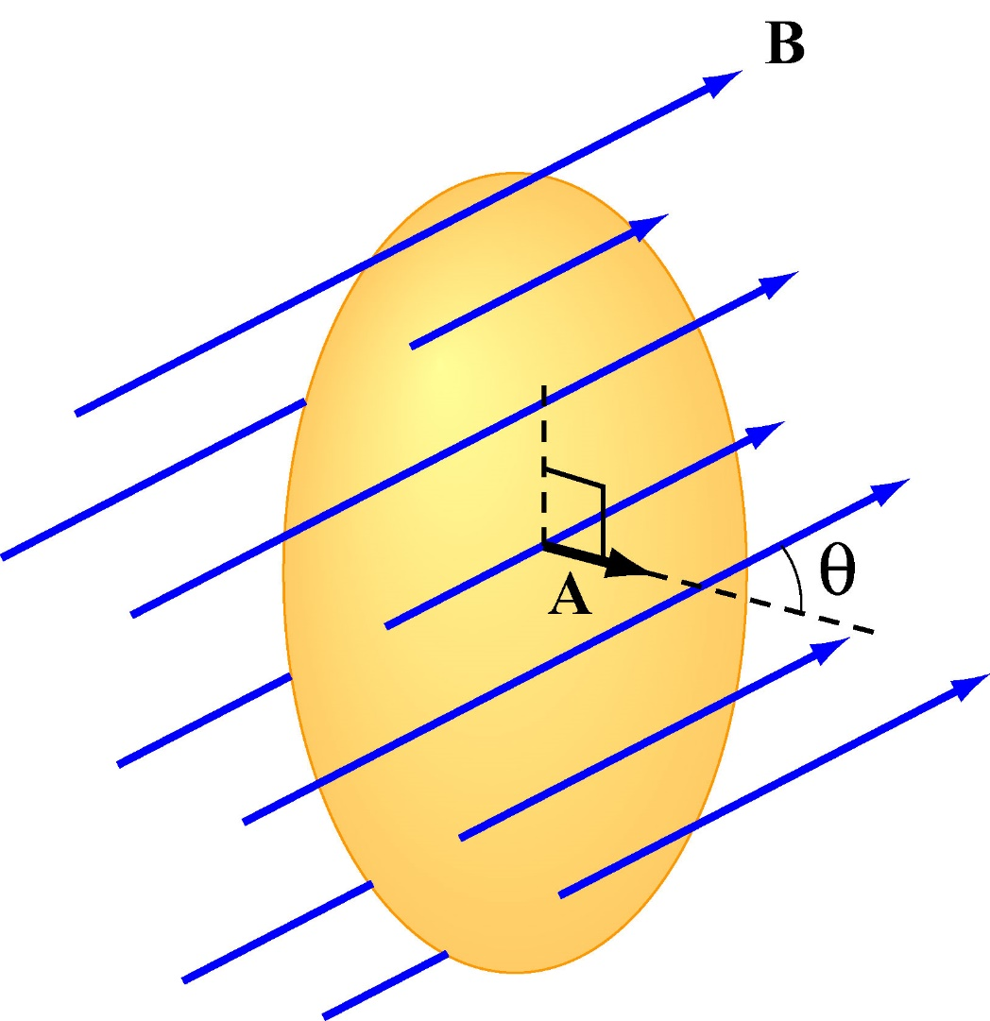
Magnetic Flux Thru Wire Loop
Analogous to Electric Flux (Gauss’ Law)
(1) Uniform B
(2) Non-Uniform B

Slide 7
What is EMF?
Looks like potential. It’s a “driving force” for current

Slide 8
Faraday’s Law of Induction
A changing magnetic flux induces an EMF, a curling E field

Slide 9
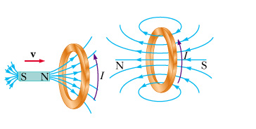
Minus Sign? Lenz’s Law
Induced EMF is in direction that opposes the change in flux that caused it

Slide 10
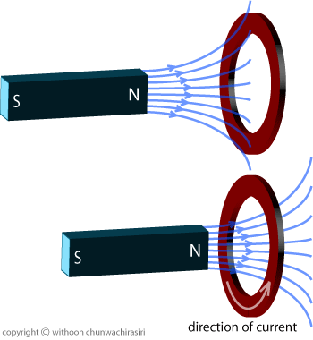

Slide 11
Faraday’s law indicates that the induced emf and the change in flux have opposite algebraic signs.
This has a physical interpretation that has come to be known as Lenz’s law.
Developed by German physicist Heinrich Lenz
Lenz’s law: the induced current in a loop is in the direction that creates a magnetic field that opposes the change in magnetic flux through the area enclosed by the loop.
The induced current tends to keep the original magnetic flux through the circuit from changing.

Slide 12
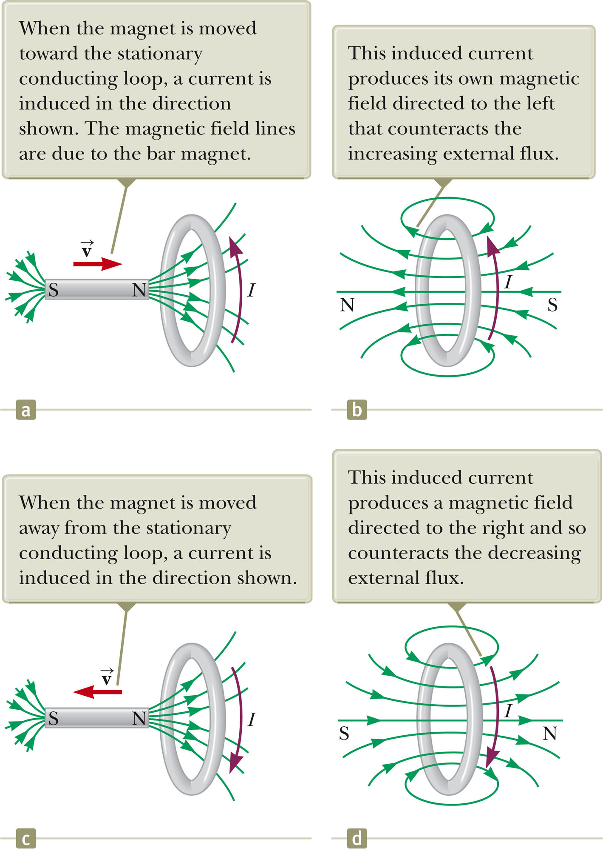

Slide 13
Faraday’s Law of Induction
Changing magnetic flux induces an EMF
Lenz: Induction opposes change

Slide 14
Ways to Induce EMF
Quantities which can vary with time:
Magnitude of B
Area A enclosed by the loop
Angle θ between B and loop normal

Slide 15
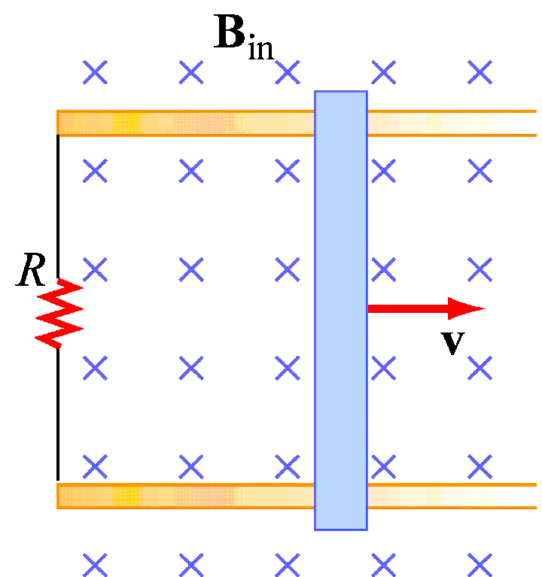
Group Problem: Changing Area
Conducting rod pulled along two conducting rails in a uniform magnetic field B at constant velocity v
Direction of induced current?

Slide 16
Faraday’s Experiment – Findings
At the instant the switch is closed, the ammeter changes from zero in one direction and then returns to zero.
When the switch is opened, the ammeter changes in the opposite direction and then returns to zero.
The ammeter reads zero when there is a steady current or when there is no current in the primary circuit.

Slide 17
Faraday’s Experiment – Conclusions
An electric current can be induced in a loop by a changing magnetic field.
This would be the current in the secondary circuit of this experimental set-up.
The induced current exists only while the magnetic field through the loop is changing.
This is generally expressed as: an induced emf is produced in the loop by the changing magnetic field.
The actual existence of the magnetic flux is not sufficient to produce the induced emf, the flux must be changing.

Slide 18
Faraday’s Law of Induction Statements
The emf induced in a circuit is directly proportional to the time rate of change of the magnetic flux through the circuit.
Remember Φ_{B} is the magnetic flux through the circuit and is found by
If the circuit consists of N loops, all of the same area, and if Φ_{B} is the flux through one loop, an emf is induced in every loop and Faraday’s law becomes

